Slide 1
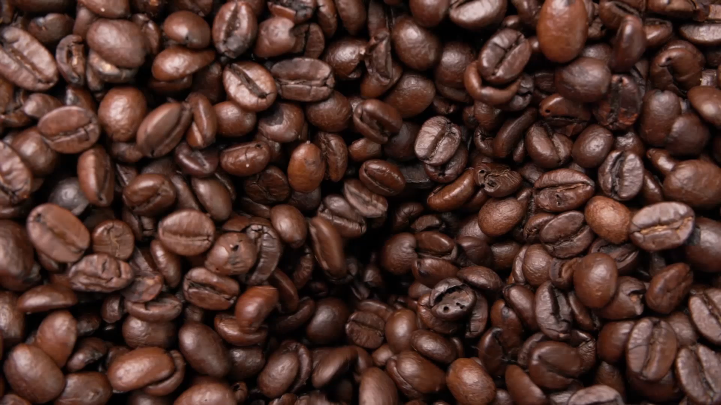
Predicting Global Coffee Quality Using Machine Learning
CQI Dataset Analysis
Lindsey Bowen, Spring 2026
Notes:
Used the Coffee Quality Institute to see whether coffee quality can be predicted from production related features, rather than from the sensory scoring features that directly make up the final cupping score.

Slide 2
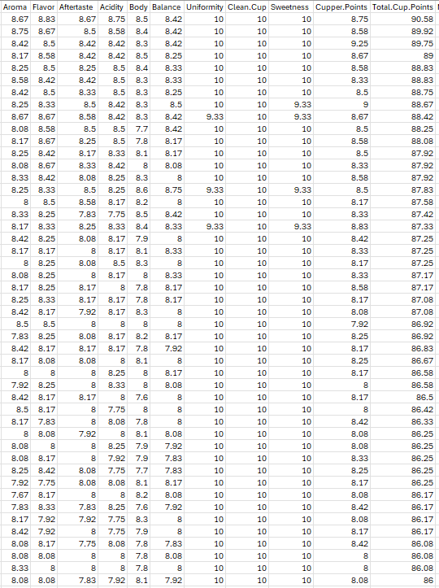

Problem Definition
Coffee quality is subjective, but experts use standardized “cupping scores”, which depend on sensory traits like aroma, flavor, and balance
Today’s Question: Can we predict coffee quality using production data alone?
Notes:
Coffee quality is subjective, but in industry settings, it is standardized using a cupping score, which is influenced by sensory traits like aroma, flavor, and balance.
My main question was: can we predict coffee quality using only production data, without using the individual sensory columns?

Slide 3

Why This Matters
Coffee quality is an important factor in price, consumer perception, and market value.
Predicting quality could help improve crops and assist buyers in sourcing high-quality coffee.
Did you know?
Finland has the highest per capita of coffee consumption at 12kg per person annually.
Notes:
This matters because coffee quality affects price, consumer perception, and market value. If quality can be predicted earlier using production data, that could improve crops and farmers improve practices and help buyers identify promising coffees more efficiently.

Slide 4
Methodology and Model Choice
Methods Chosen were Random Forest and XGBoost, which is high-performing.
Two different models were used, Regression and Classification models.
In the dataset, two csv’s are included, Arabica and Robusta. Only Arabica was used for clarity.
Notes:
I approached this project using two machine learning tasks: regression and classification. Regression predicts exact coffee scores, while classification predicts whether a coffee is high quality or not.
I used two models: XGBoost and Random Forest. Both are tree-based ensemble models that are well-suited for nonlinear relationships.
XGBoost builds trees sequentially, improving on previous errors, while Random Forest builds trees independently and averages them.

Slide 5
Research Questions: What are we trying to find?
Can we predict exact coffee scores?
Can we identify high-quality coffee?
Which features influence quality the most?
Do different models agree with each other?

Slide 6

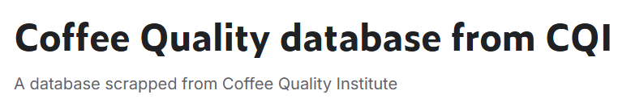
The Data
The dataset “Coffee Quality database from Coffee Quality Institute was used, which has 44 columns, such as altitude, country of origin, region, processing methods, etc.
The main columns that contribute to the cupping score are Aroma, Flavor, Aftertaste, Body, Balance, and Uniformity, all traits that seasoned coffee tasters look for when cupping coffee.
https://www.kaggle.com/datasets/volpatto/coffee-quality-database-from-cqi?resource=download
Notes:
The sensory features like aroma, flavor, and balance directly contribute to final score, so they were removed to avoid data leakage.

Slide 7
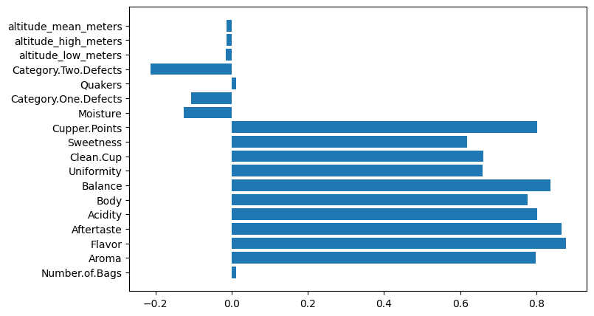
Statistical Baseline
In this dataset, there are 1310 samples with a mean cupping score of about 82.18.
Visualization of Correlated Features
Statistical Baseline of Total Cupping Points
 | Total.Cup.Points
count | 1310.00
mean | 82.18
std | 2.69
min | 59.83
max | 90.58
range | 59.83 – 90.58
Notes:
The dataset contains about 1310 samples, with an average score of around 82 and a standard deviation of about 2.7.
This tells us that most coffee scores are tightly clustered, which already makes prediction more difficult.
Looking at correlations, sensory features show strong relationships with the score, which is expected since they contribute directly to it.
Production features like altitude, moisture, and defects show much weaker linear relationships.
A negative correlation means that as a feature increases, the coffee score tends to decrease, such as with defects.
This suggests that production features alone may not fully explain coffee quality.

Slide 8

XGBoost: Regression and Classification
Notes:
I first applied XGBoost to both regression and classification tasks to see how well it performs.

Slide 9
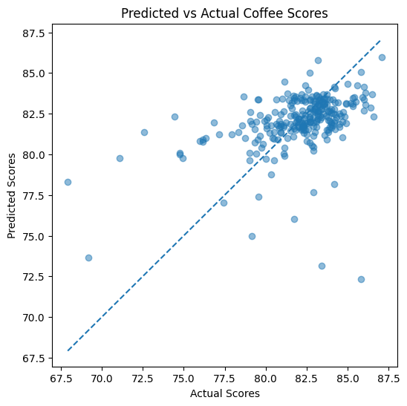
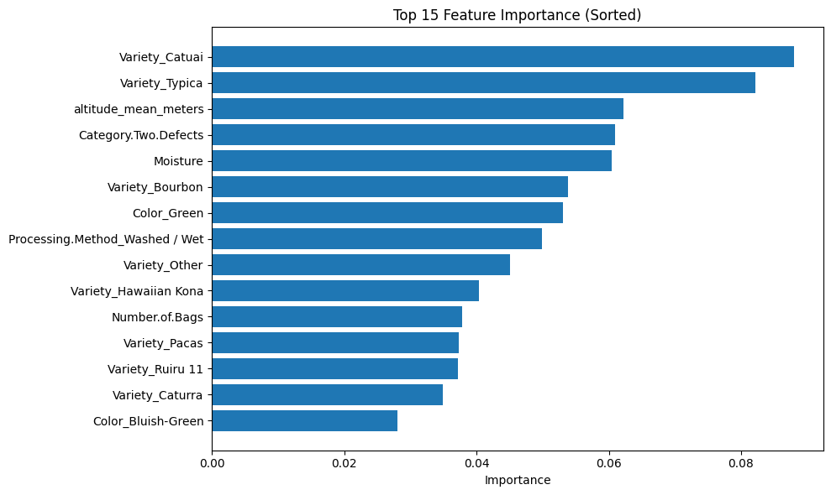
XGBoost: Regression Model
Evaluation Metrics:
Root Mean Squared Error: 2.27279
R² : 0.14618214105257188
MAE: 1.6772725368820074
Notes:
HALFWAY POINT – 7.5
The question was “how well can we predict the exact coffee score using production features?
First, we focus on the plots that are on the line, which are perfect predictions. Scattered points are errors, indicating prediction error.
Here are the top 15 features with noninformative columns and noise dropped. We see that the variety Catuai and Typica, along with altitude were stronger predicting factors for the coffee cupping score. We removed sensory features such as aroma and flavor to avoid data leakage that contribute directly to the final score.
For the regression models, we use evaluation metrics RMSE and R2, which measures how much of the variation in our coffee score can explain.
RMSE shows that on average, predictions are off by about 2.3 points on average and R2 explains only ~14.6 % of the variation in coffee scores. The Mean Absolute Error shows that predictions are off by about 2 points. The low R2 score suggests that coffee quality really does depend on factors not present in the dataset such as the human evaluation from sensory characteristics.

Slide 10
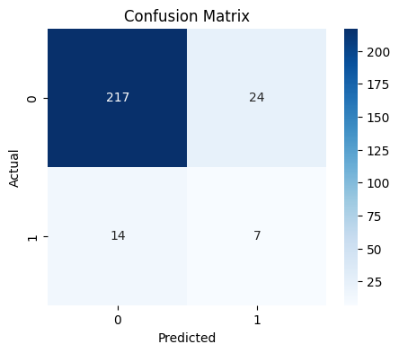
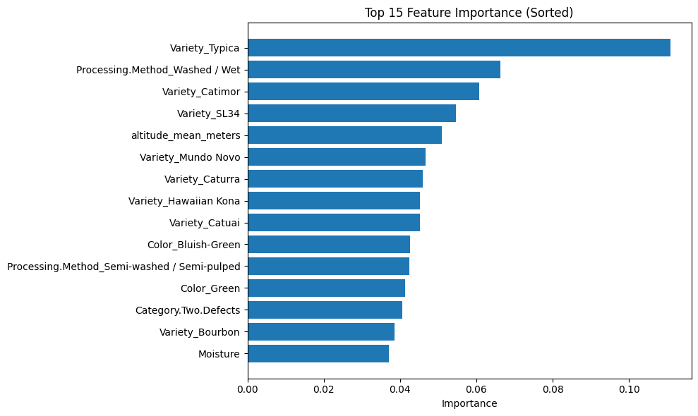
XGBoost: Classification Model
A baseline model was built to predict “high-quality” coffee versus “low-quality”.
Since only about 8% of samples were high quality, class weighting was used to account for class imbalance and improve the detection of those rarer cases.
Evaluation Metrics:
Accuracy: 0.85496
Precision: 0.23
Recall: 0.33
F1 Score: 0.27
Notes:
In this baseline model, we see that accuracy is relatively high, but recall is low. This means the model misses many high-quality coffees due to class imbalance.
We also see a lot of the same but differently ordered features.
OPTIONAL – Feature descriptions
Ex: Typica variety is one of the oldest and most genetically significant of arabica coffee, located in southwestern Ethiopia.
Processing method also contributes heavily to both XGBoost models. Washed coffee is the process where coffee is fermented with water, dry referes to without.
Semi washed/semi pulped is a hybrid between washed and natural processing – outer skin removed, some sticky layer left, and beans are only partially washed
Other features: Variety Catimor: hybrid coffee variety developed in Portugal in 1959 by breeding Caturra (Arabica) and Timor Hybrid (Arabica + Robusta)
Variety SL34: developed in 1930s by Scott Agricultural Laboratories in Kenya, celebrated for producing exceptionally high quality coffee
Category 2 defects: minor physical defects like broken beans, discoloration, and insect damage
Moisture: water content of the bean itself (ideal is around 10-12%)
Color Green or Bluish Green indicates freshness, processing quality and storage conditions. Green is normal and ind. Slightly gged or typical beans, bluish green is fresher and better processed, associated with specialty coffee.

Slide 11
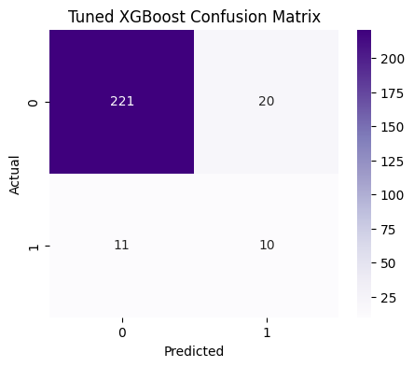
Hyperparameter Tuning For XGBoost Classifier
 | Accuracy | Precision | Recall | F1-Score
Base | 0.844962 | 0.22806 | 0.33333 | 0.269231
Tuned | 0.881679 | 0.33333 | 0.47619 | 0.392157
Tuned parameters: n_estimators,, max_depth, learning_rate
Notes:
To improve the model, I tuned the number n_estimators, max_depth, and learning_rate.
For this classifier, F1 is a good tuning metric because it provides precision for fewer false positives and recall to catch more high-quality coffee samples.
Using the F1 metric, I tuned the number of trees to 50, tree depth to 7, and learning rate to 0.10 for XGBoost classification. I selected the best model using F1 score because the dataset is highly imbalanced and accuracy alone would be misleading.
The tuning results produced a modest improvement, which suggests that feature quality and class imbalance limited performance more than parameter choice. We see that the tuned model now predicts high-quality coffee 33% of the time correctly (precision), a higher detection of the rare class (recall) and the F1 score shows that the model is now much better at balancing precision and accuracy. We see that the tuned model actually predicts more true positives, from 7 to 10.

Slide 12

Random Forests: Regression and Classification
Notes:
Review of Random Forest: builds many decision trees independently and averages their predictions, which helps capture nonlinear relationships and reduces overfitting.

Slide 13
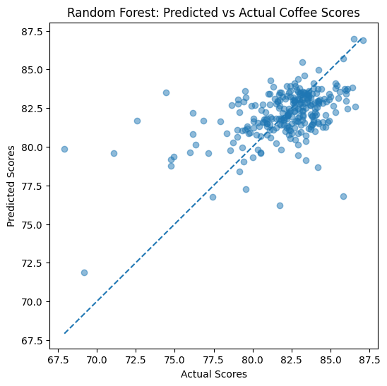
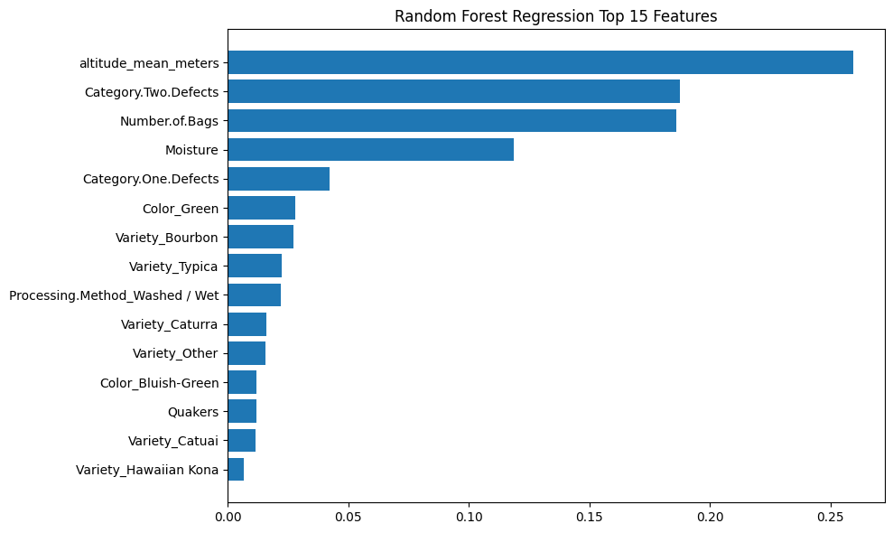
Random Forest: Regression Model
Evaluation Metrics:
Root Mean Squared Error: 2.2825
R² : 0.26442999262152056
MAE: 1.602423719859442
Notes:
We used a Random Forest Regressor to predict the exact coffee quality score using production features, same as before. Since this is the regression model, we predict exact coffee quality scores, rather than high quality/low quality.
Here we see a root mean squared error of app. 2.28, and an R^2 of .26, meaning that the predictions are off by about 2.28 points, and the ~28.44% of the variation is explained by R^2. The MAE is not too different from before. We will get to comparison shortly

Slide 14
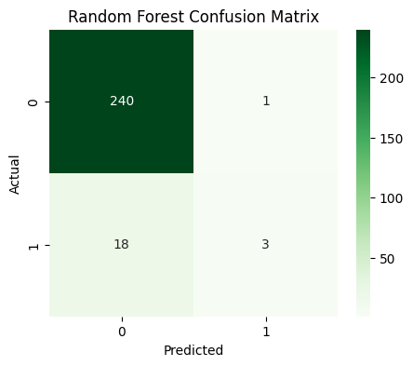
Random Forest: Classification Model
Evaluation Metrics:
Accuracy: 0.92748
Precision: 0.75
Recall: 0.14
Notes:
We see from the confusion matrix that there were very few false positives but many false negatives.
We see from the top 15 features that they are all quite similar
Although accuracy and precision and high, recall is very low, meaning the model fails to detect high quality coffees. This shows that accuracy alone is misleading in imbalanced datasets.

Slide 15

Comparison of XGBoost and RF Regression Models
Model | RMSE | R^2
XGBoost | 2.27279 | 0.14618
RF | 2.2825 | 0.26443
Notes:
Notice that RMSE is slightly lower for Random Forest than XGBoost, meaning that it explains more of the variation in coffee quality.

Slide 16
Comparison of XGBoost and RF Classification Models
Accuracy: 0.92748
Precision: 0.75
Recall: 0.14
F1-Score: 0.24
Accuracy: 0.881679
Precision: 0.33
Recall: 0.48
F1-Score: 0.39

Slide 17

Errors and Limitations
Dataset is highly imbalanced (~8% high-quality)
A lot of production features show weak correlation with quality
Some features (e.g., Number of Bags) improve prediction but may reflect dataset-specific biases rather than causal relationships.
Notes:
Unfortunately I didn’t realize I had not removed these features until much more recently.

Slide 18

Conclusion
Coffee quality is difficult to predict using production features alone
Regression models showed limited predictive power (low R^2)
Classification improved with hyperparameter tuning
Tree based models captured nonlinear relationships better than linear models
Final Takeaway: Model performance Is limited more by data quality than model choice.
Notes:
The “best” model: For regression, Random Forest explains more variance. For classification, tuned XGBoost provided the best balance between precision and recall.
Coffee quality is difficult to predict using production features, shown by low R^2, a moderate RMSE, and scattered prediction plots
Regression models showed limited predictive power, shown by R2 < 0.3, predictions are not tightly clustered, and a large unexplained variance.
Classification improved with tuning -> see comparison table in hyperparameters
Correlation showed weak linear relationships, tree models still foun meaningful patterns, and linear models would perform worse?
5. Number of bags boosted performance but logically it doesn’t cause quality
Model performance is limited more by data quality than model choice.
XGBoost

